Slide 1
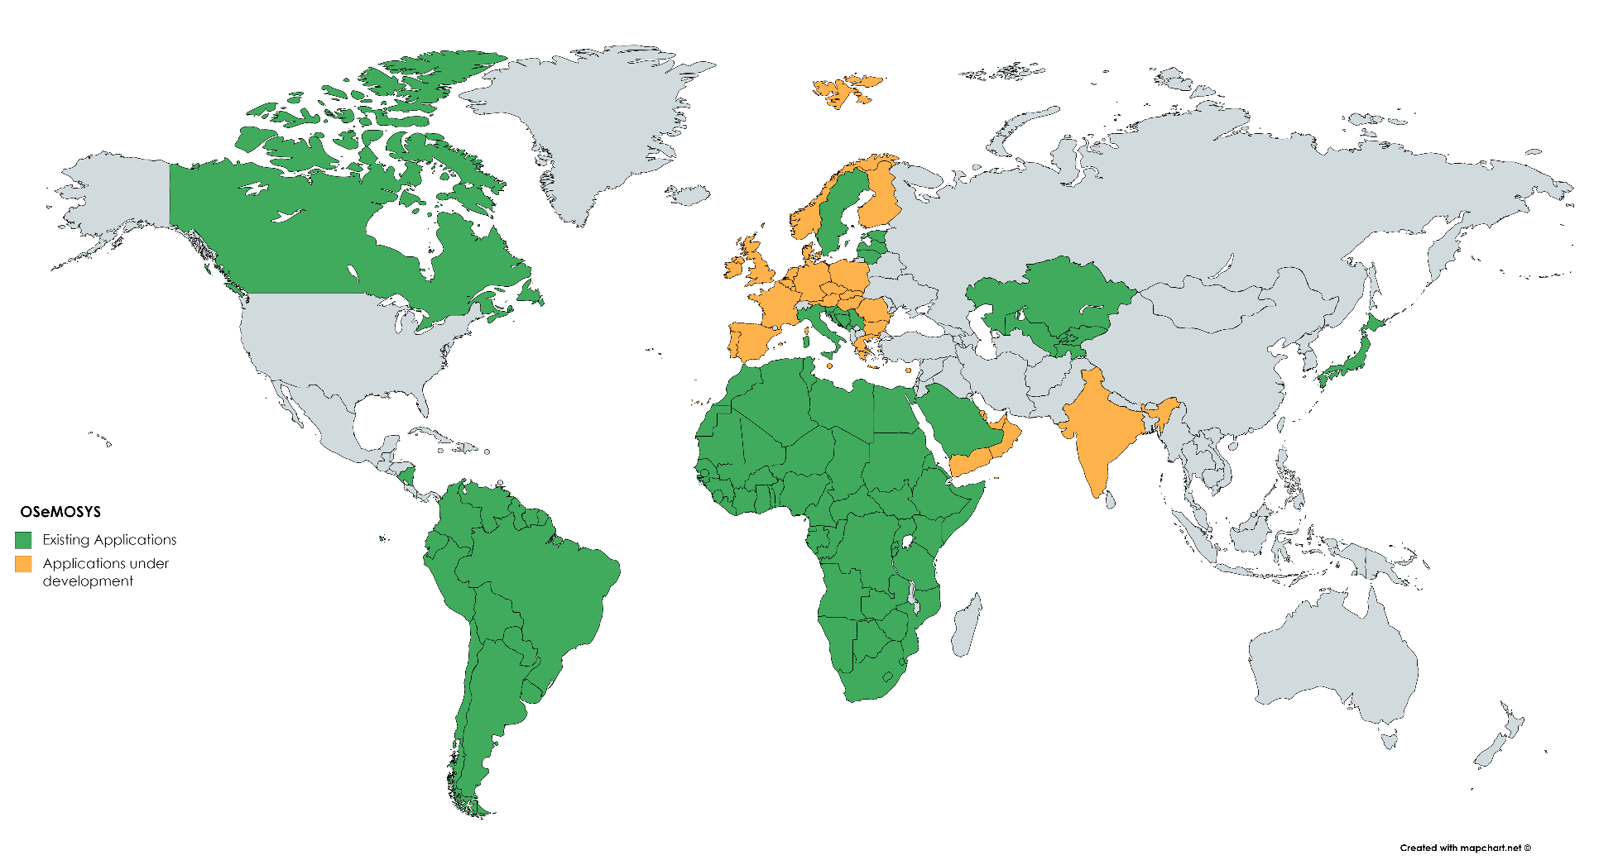
OSeMOSYS Applications

Slide 2
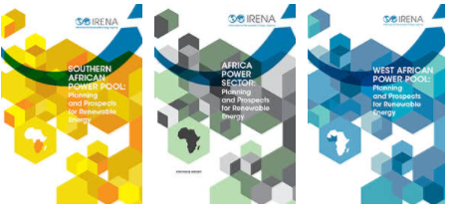

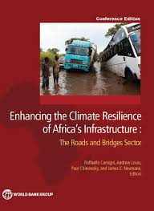
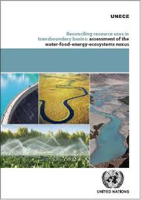
OSeMOSYS Applications
OSeMOSYS
IRENA African Power Pools: Planning and Prospects of Renewable Energy
IEA WEO 2014 – Africa Energy Outlook
WB – Enhancing the Climate Resilience of African Infrastructure
UNECE transboundary nexus assessments
(Sava and Drina)

Slide 3
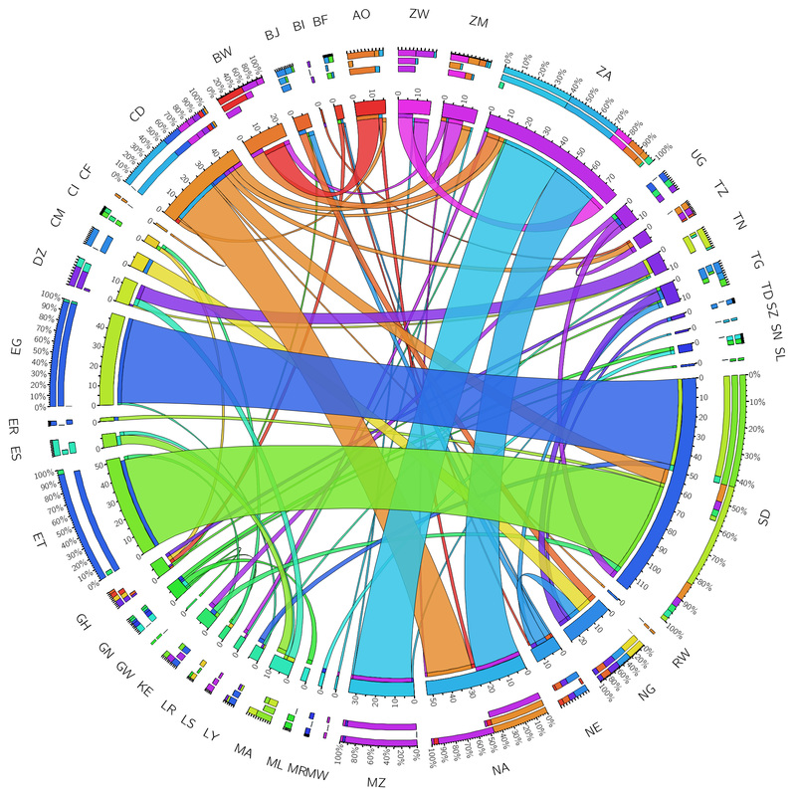
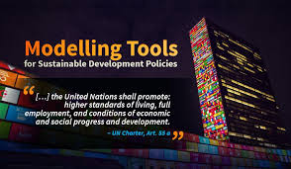
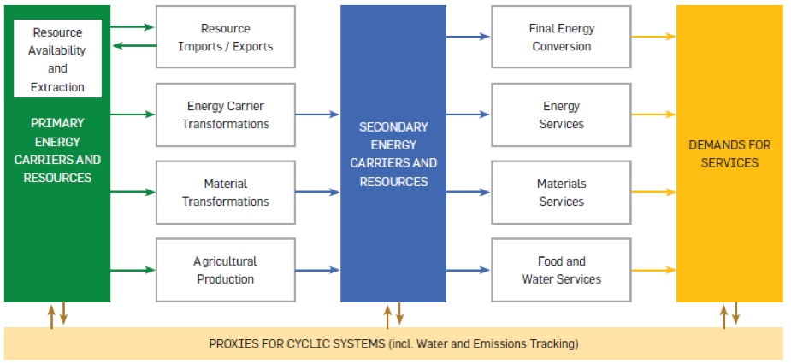
OSeMOSYS Applications
OSeMOSYS
TEMBA – The Energy Model Base for Africa
SAMBA – South America Model Base
CLEWS applications (GLUCOSE, Uganda, Nicaragua, Zimbabwe, Mauritius, Kenya, Bolivia, …)
Among UNDESA modelling tools for sustainable development policies.

